Slide 1
Scientific Communication Skills:
What to do…and what not to do
SC INBRE Workshop
Monday June 17th, 2019
Susan K. Wood, Ph.D.
Bldg 1. Rm, D28A
803-216-3522
Susan.Wood@uscmed.sc.edu

Slide 2
Why is it important to be able to speak well in public?
Job Interviews
Communicating your scientific findings
Getting research funding
Marketing/Selling
Teaching

Slide 3
Different Types of Talks
The Hour Seminar
The Elevator Talk
The Mini-Symposium Talk
The Poster Talk
Cocktail Hour
The Didactic Lecture

Slide 4
Presenting a Scientific Seminar
Overcoming FEAR of public speaking
Delivery techniques
Appearance
Scientific content of talk

Slide 5
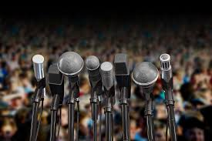
Fear of Public Speaking
The average person in North America ranks the fear of public speaking higher than the fear of death!
"There are two types of speakers: those who are nervous and those who are liars.“
-Mark Twain
“According to most studies, people's number one fear is public speaking. Number two is death. Death is number two. Does that sound right? This means to the average person, if you go to a funeral, you're better off in the casket than doing the eulogy.”
-Jerry Seinfeld

Slide 6
Fear of Public Speaking
PREPARATION…
is the key to beating nerves

Slide 7
How to overcome fear of public speaking: Preparation
Clearly organize your talk
Eliminate the fear of REJECTION
Watch yourself in a mirror (pay attention to facial expressions, gestures, body movements etc.)
Practice breathing calmly
Practice, Practice, Practice…and then practice again.
  OUT LOUD and preferrably to an audience

Slide 8
How to overcome fear of public speaking: Preparation
Know the room. Arrive early, walk around the speaking area and practice using the microphone and any visual aids.
Visualize yourself giving your speech. Imagine yourself speaking, your voice loud, clear and confident. Visualize the audience clapping – it will boost your confidence.
Realize that people want you to succeed. Audiences want you to be interesting, stimulating, informative and entertaining. They’re rooting for you.

Slide 9
How to overcome fear of Public Speaking: Strategies during the talk
Deal with anxiety symptoms as they occur:
Dry mouth? Take a little sip of water.
Knees knocking? Shift your weight and flex your knees.
Hands trembling? Put them together or grab the podium briefly.
Voice quivering? Pause, take a deep breath or two, and smile!
Heart pounding? Take a breath and relax…this stress response is increasing blood flow to your brain!
Learn to channel your nervous energy into positive energy!

Slide 10
Presenting a Scientific Seminar
Overcoming FEAR of public speaking
Delivery techniques
Appearance
Scientific content of talk

Slide 11
Delivery Techniques: Before you start
Know your material. Pick a topic you are interested in. Know more about it than you include in your talk. Use humor, personal stories and conversational language – that way you won’t easily forget what to say.
Know the audience. Greet some of the audience members as they arrive. It’s easier to speak to a group of friends than to strangers. Make the level of detail in the talk appropriate for the audience.
Relax. Begin by addressing the audience. It buys you time and calms your nerves. Pause, smile and count to three before saying anything.
http://www.toastmasters.org/tips.asp

Slide 12
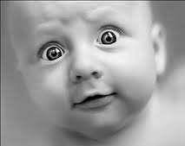

Delivery Techniques:
Maintain good eye contact with your audience. When you engage your audience, they become engaged in your topic.
Proper hand gestures are important. If you use your hands correctly they can help you emphasize your points and connect with your audience.
    The least watched TED talks (~124,000 views) used an average of 272 hand gestures
    The top-ranked TED talks (~7.4M views) had an average of 465 hand gestures during the same length of time!

Slide 13
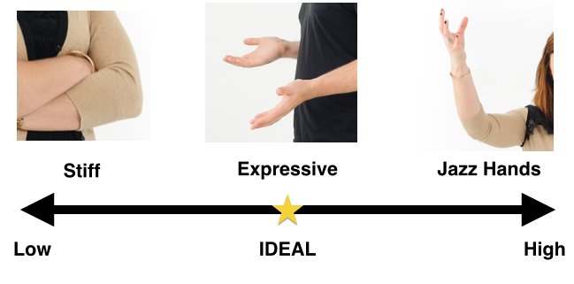
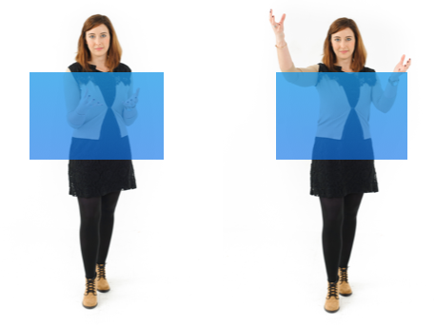
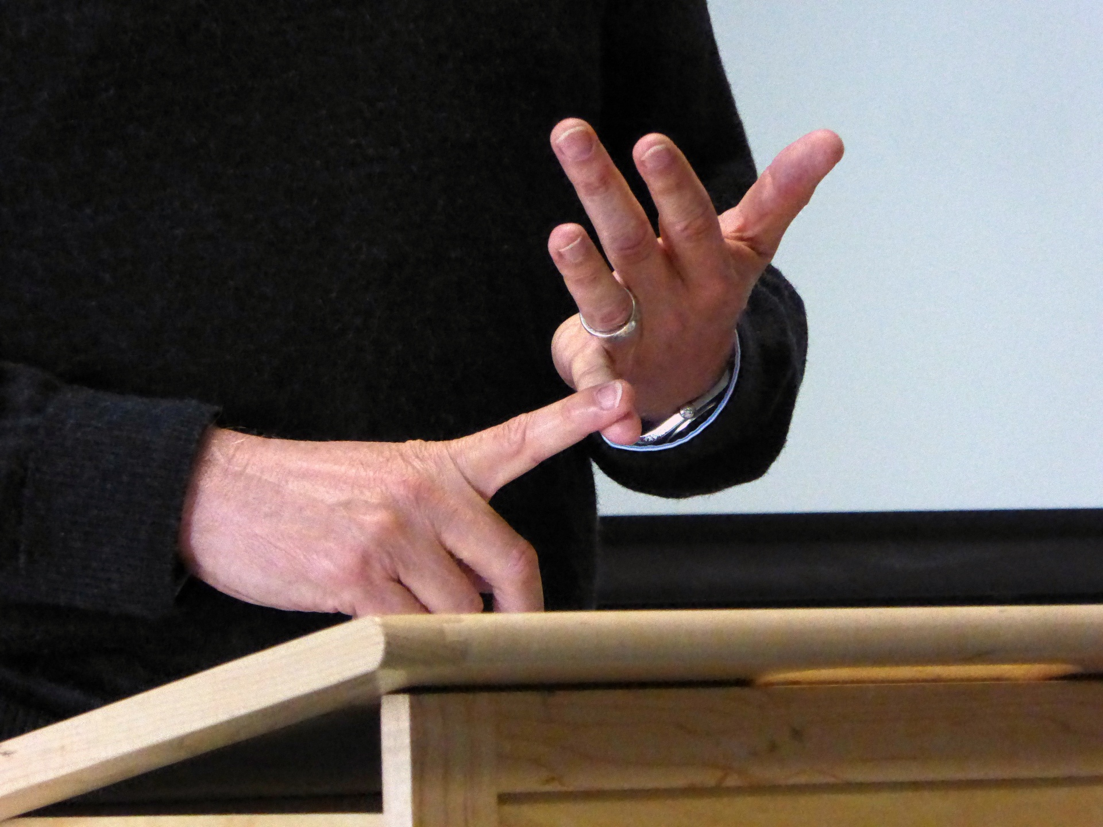

Delivery Techniques:
HAND GESTURES:
Pointing is viewed as aggressive and should be avoided
Thescienceofpeople.com
Notes:
http://www.scienceofpeople.com/2015/08/20-hand-gestures-using/?utm_expid=40598772-14.WOG0NyNsTDO_D8Y2heCNfQ.1&utm_referrer=https%3A%2F%2Fwww.google.com%2F

Slide 14
Delivery Techniques:
Gain experience. Experience builds confidence, which is the key to effective speaking.
Practice. Practice. Practice! Rehearse out loud with all equipment you plan on using. Work to control filler words (“um” “uh”); Practice, pause and breathe. Practice with a timer and allow time for the unexpected.

Slide 15
Delivery Techniques: What NOT to do
Avoid leaning or bracing yourself against the podium, this can appear stiff and awkward.
Don’t apologize for any nervousness or problem – the audience probably never noticed it.
Concentrate on the message – not the medium. Focus your attention away from your own anxieties and concentrate on your message and your audience.
BUT…don’t overthink the audience’s reaction

Slide 16
Presenting a Scientific Seminar
Overcoming FEAR of public speaking
Delivery techniques
Appearance: In any situation you have only seconds to create a good first impression
Scientific content of talk

Slide 17



Appearance: Women
Proper dress can include business slacks, button-up shirts, and jackets. Also acceptable is close toed flats or heels, knee length skirts and blouses.
Jeans with holes in them, tank or tube tops, miniskirts and flip flops are unprofessional.

Slide 18
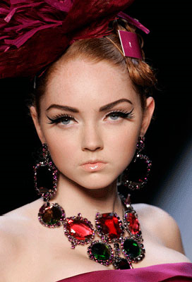



Appearance: Women
Women should also avoid flashy jewelry, big hair, and too much makeup. Jewelry should be modest and not distracting, and hair combed or styled and kept out of the face.
Notes:
The way you act during a presentation can also affect the audience’s perception of you.
Dressing inappropriately may cause you to act in a way that is distracting to the audience.
Fiddling with your jewelry
Tugging at clothing
Brushing hair out of your face
The behaviors cause your audience to focus on what you are doing rather than what you are saying.

Slide 19
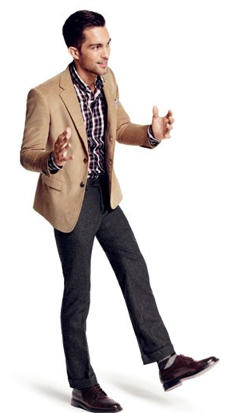

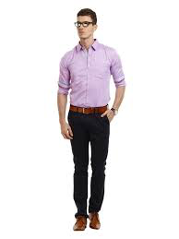

Appearance: Men
Proper dress includes slacks and button-up shirts, with a jacket and tie optional, depending on the speech and audience. Avoid very casual shoes.
Too Casual

Slide 20
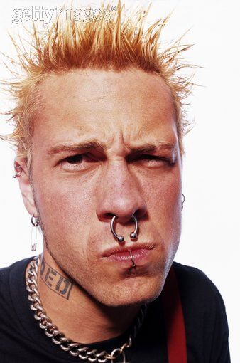
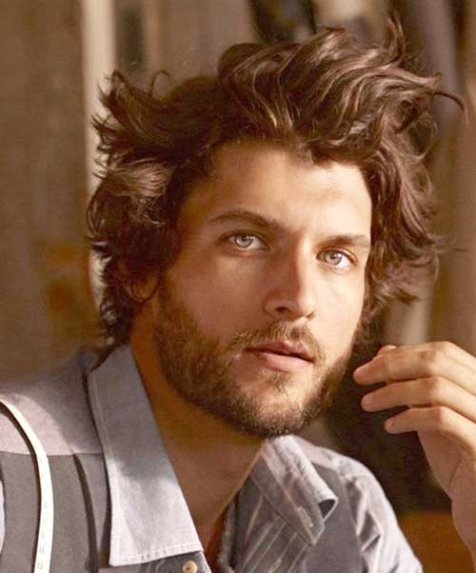
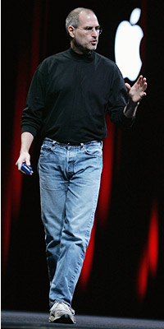

Appearance: Men
Avoid t-shirts —especially those with inappropriate graphics — shorts, and flip-flops. Avoid dirty or visibly worn/wrinkled clothing, as well as hats and sunglasses and casual shoes. A clean shaven face or well kept facial hair is also important in achieving the proper look. Men should also avoid flashy piercings.
Notes:
The way you act during a presentation can also affect the audience’s perception of you.
Dressing inappropriately may cause you to act in a way that is distracting to the audience.
Fiddling with your jewelry
Tugging at clothing
Brushing hair out of your face
The behaviors cause your audience to focus on what you are doing rather than what you are saying.

Slide 21

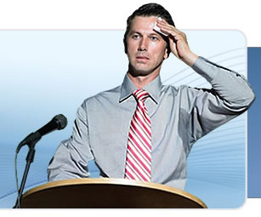
Appearance
What about sweating?
Avoid dark colored shirts.
Wear a jacket over the shirt to hide the sweat.

Slide 22
Presenting a Scientific Seminar
Overcoming FEAR of public speaking
Delivery techniques
Appearance
Scientific content of talk

Slide 23
Scientific Content for oral presentation
Every presentation should have three parts. Tell the audience what you’re going to tell them, tell them, and then tell them what you told them.
Introduction should emphasize the importance/significance/clinical relevance of your material without giving unnecessary information.
Outline the talk - Present material according to the outline.
Present a clear hypothesis and explain how this hypothesis will be tested.

Slide 24
Scientific Content for oral presentation
Divide the talk into manageable sections and present summary/conclusions at the end of each of these sections.
Explain all elements on each figure.
Present a single concept/slide.
Provide overall summary/conclusions at the end.
Acknowledge contributors.
Keep to the allotted time***

Slide 25
Presenting a Scientific Seminar
Overcoming FEAR of public speaking
Delivery techniques
Appearance
Scientific content of talk
Questions?

Slide 26
Important tips in preparing for the poster
Give yourself time to prepare
Know the practical stuff (dimensions, etc.)
Design a clean, easy-to-follow appearance
Easy to read (from 10 feet away) and keep wording to a minimum
Summary (w/ figure?)
References?
Practice, practice! (3 min target)

Slide 27
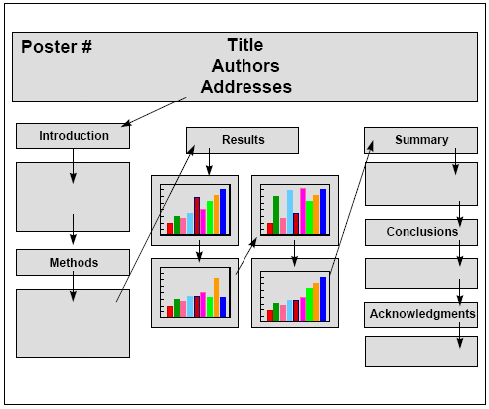
Notes:
Figure legends optional

Slide 28
What makes a good poster?
Important info should be readable from 10 feet away (GRAPH AXES!!!)
Title is short and draws interest
Word count (300-800 words)
Text is clear and concise
Bullets, numbering and headings make it easy to read and to follow
Consistent and clean layout
Includes: Title, affiliation, names, and acknowledgements
Notes:
Don’t use less than 20-pt. font

Slide 29
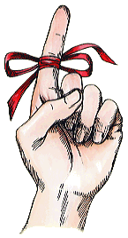
3 most common mistakes
1. Too much text
2. Font size too small (*graph axes*)
3. Not planning for space
The poster is a prop!
Notes:
Don’t use less than 20-pt. font

Slide 30
Acknowledgements
serif: Times New Roman, etc.
sans serif: Arial; Lucida Sans Unicode; etc.

Slide 31
The meeting: getting ready
Scope out site beforehand
Get some sleep
Know the dress code
Practical stuff to bring:
-extra copy on flashdrive
-’repair kit’: (tape; marker; white-out; etc.)
-pen/notebook
-reprints (?)
-water, cough drops

Slide 32
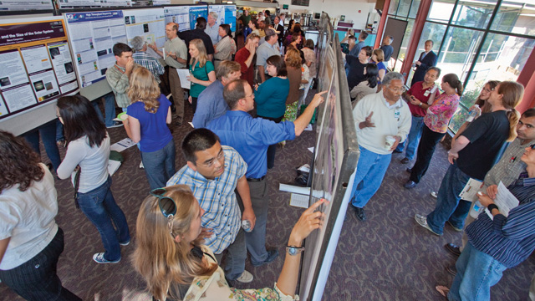
The meeting:
presenting
Be personable
Do the walk-through
Focus on the big stuff (this is not a manuscript)
Ask questions
Stay with the poster
RELAX!

Slide 33

Missing large take home message from each set of figures
Font cramped in space
Awkward white space
Illegible axes
FONT too small and too much
FONT size
Caption not aligned with figure
Font cramped in space

Slide 34
Questions?
Useful links for poster tips:
https://www.the-scientist.com/?articles.view/articleNo/31071/title/Poster-Perfect/
https://guides.nyu.edu/posters
https://www.chemistryworld.com/careers/how-to-win-a-poster-competition/3008058.article

